Slide 1
SEM Basics 2
Byrne Chapter 2
Kline pg 7-15, 50-51,
91-103, 124-130

Slide 2
Kline!
Kline (page 7-8) talks about the different types of approaches:
Strictly confirmatory
Alternative models
Model generation

Slide 3
Types of SEM
Strictly confirmatory – the Byrne approach
You have a theorized model and you accept or reject it only.

Slide 4
Types of SEM
Alternative models – comparison between many different models of the construct
This type typically happens when different theories posit different things
Like is it a 6 factor model or 4 factor model?

Slide 5
Types of SEM
Model generating – the original model doesn’t work, so you edit it.
(this is where you might modify the order or variables or the places that arrows go with the same variables)

Slide 6
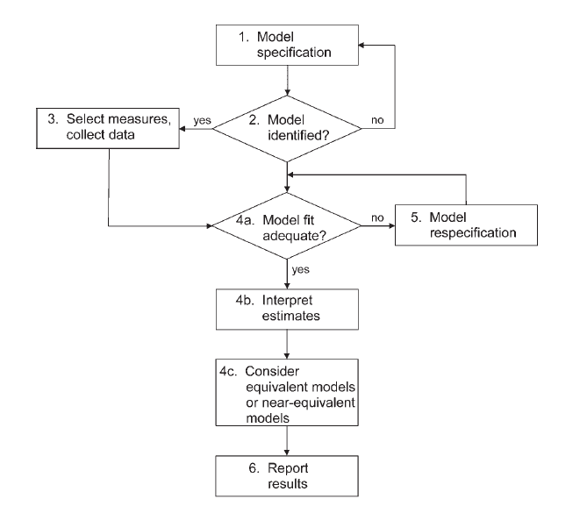

Slide 7
Specification
Specification is the term for generating the model hypothesis and drawing out how you think the variables are related.

Slide 8
Specification Errors
Omitted predictors that are important but you left them out
LOVE – left out variable error

Slide 9
Covariances
To be able to understand identification, you have to understand that SEM is an analysis of covariances
You are trying to explain as much of the variance between variables with your model

Slide 10
Covariances
You can also estimate a mean structure
Usually when you want to estimate factor means (actual numbers for those bubbles).
You can compare factor means across groups as an analysis.

Slide 11
Sample Size
The N:q rule
Number of people = N
q number of estimated parameters (will explain in a bit)
You want the N:q ratio to be 20:1 or greater in a perfect world, 10:1 if you can manage it.

Slide 12
Identification
Essentially, models that are identified have a unique answer (also invertable matrix)
That means that you have one probable answer for all the parameters you are estimating
If lots of possible answers exist (like saying X + Y = some number), then the model is not identified.

Slide 13
Identification
Identification is tied to:
Parameters to be estimated
Degrees of Freedom

Slide 14
Identification
Free parameter – will be estimated from the data
Fixed parameter – will be set to a specific value (i.e. usually 1).

Slide 15
Identification
Constrained parameter – estimated from the data with some specific rule
I.e. Setting multiple paths to some variable name (like cheese). They will be estimated but forced to all be the same
Also known as an equality constraint

Slide 16
Identification
Cross group equality constraints – mostly used in multigroup models, forces the same paths to be equal (but estimated) for each group

Slide 17
Identification
Other constraints that aren’t use very often:
Proportionality constraint
Inequality constraint
Nonlinear constraints

Slide 18
Figuring out what’s estimated
1
So each path without a one will be estimated:
4 paths (regression coefficients)
Then each error term variance (not shown) will be estimated:
6 variances
Remember the paths will not be estimated because they include a 1 on them.
Each factor variance will be estimated:
2 variances
The covariance arrow will be estimated:
1 covariance
1

Slide 19
Degrees of Freedom
Note: DF now has nothing to do with sample size.
Possible parameters
P(P+1) / 2
Where P = number of observed variables

Slide 20
Degrees of Freedom
P for our model = 6 (6+1) / 2 = 21
DF = possible parameters – estimated parameters
df = 21 – 13 = 8

Slide 21
Identification
Just identified – you have as many things to estimate as you do degrees of freedom
That means that df = 0.
EEEK.

Slide 22
Identification
Over identified – when you have more parameters you could estimate than you do
df is a positive number.
GREAT!

Slide 23
Identification
Under identified – you are estimating more parameters than possible options you have
df = negative
BAD!

Slide 24
Identification
Empirical under identification – when two observed variables are highly correlated, which effectively reduces the number of parameters you can estimate

Slide 25
Identification
Even if you have an over identified model, you can have under identified sections.
You will usually get an error in the output you get saying something to the effect of “you suck you forgot a 1 somewhere”.

Slide 26
Identification
The reference variable is the one you set to 1.
That helps with the df to keep over identification, gives the variables a scale, and generally helps things run smoothly.
A cool note: the variable you set does not matter.
Except in very strange cases where that particular observed variable has no relationship with the latent variable.

Slide 27
Identification
Another note: The reference variable will not have an estimated unstandardized parameter.
But you will get a standardized parameter, so you can check if the variable is loading like what you think it should.
If you want to get a p value for that parameter, you can run the model once, then change the reference variable, and run again.

Slide 28
A side note
The section on second order factors we will cover more in depth when we get to CFA
The important part is making sure each section of the model is identified, so you’ll notice that (page 36) the variance is set to 1 on the second latent to solve that problem.
You can also set a path to 1.

Slide 29
What to do?
If you have a complex model:
Start small – work with the measurement model components first, since they have simple identification rules
Then slowly add variables to see where the problem occurs.

Slide 30
Kline stuff
Chapter 2 = a great review of regression techniques
Chapter 3 = data screening review
(next slide is over page 50-51)
Chapter 4 = tells you about the types of programs available

Slide 31
Kline Stuff
Chapter 5 – specification, what the symbols are etc.
Chapter 6 – Identification (covered a lot of this)
Page 130 on has specific identification guidelines that are good rules of thumb

Slide 32
Positive Definite Matrices
One of the problems you’ll see running SEM is an error about “matrix not definite”.
What that indicates is the following:
1) matrix is singular
2) eigenvalues are negative
3) determinants are zero or negative
4) correlations are out of bounds

Slide 33
Positive Definite Matrices
Singular matrix
Simply put: each column has to indicate something unique
Therefore, if you have two columns that are perfectly correlated OR are linear transformations of each other, you will have a singular matrix.

Slide 34
Positive Definite Matrices
Negative eigenvalues – remember that eigenvalues are combinations of variance
And variance is positive (it’s squared in the formula!)
So negative = bad.

Slide 35
Positive Definite Matrices
Determinants = the products of eigenvalues
So, again, they cannot be negative.
A zero determinant indicates a singular matrix.

Slide 36
Positive Definite Matrices
Out of bounds – basically that means that the data has correlations over 1 or negative variances (called a Heywood case).

Slide 37
For now
Let’s talk about output in AMOS
Make a small path model to run and look at output.

Slide 38
Up next
Kline page 103-112 Path Models
Kline chapter 7 estimation methods
Kline chapter 8 fit indices

